Slide 1



Things you need to know to become a Serverless API Ninja
Allan A. Chua
API Days Singapore 2020

Slide 2

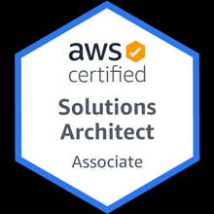


Solutions & Integrations Architect @ FWD
AWS Certified Solution Architect
1.5
Allan Chua
Years of Experience with Serverless
Writing a Book about Serverless

Slide 3



BASICS
INTEGRATIONS
CAUTION

Slide 4

Serverless Means Efficiency

Slide 5




No Servers to Manage
Reduced Security Risk & Cost
Pay only for what is used

Slide 6

Availability Zone A
Availability Zone B
Availability Zone C
Built-in High Availability & Disaster Recovery

Slide 7
$135.05
$ 270.10
1 EC2 t2.xlarge $0.185 / Hour
2 EC2 t2.xlarge $0.370 / Hour High Availability
What traditional architectures will cost you per API Cluster

Slide 8
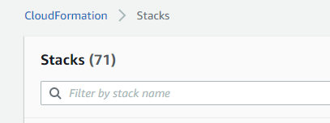
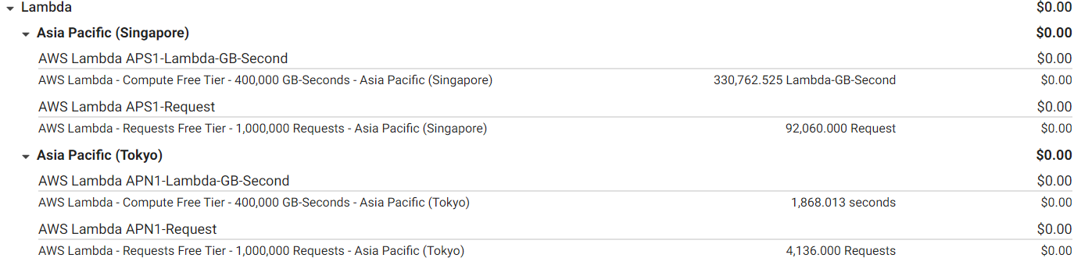
96K API calls worth 91 Hours of actual runtime
for 71 CF Stacks in DEV environment for FREE

Slide 9
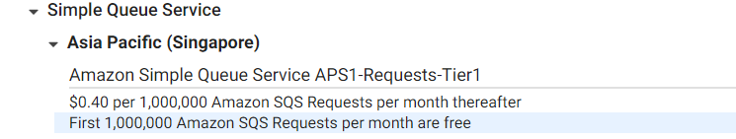
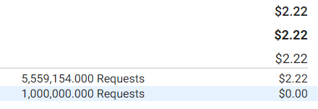
6.6 Million Queue Messages for 2$
In DEV Environment

Slide 10
$ 19,710
$ 0
$270.10 per cluster x 71
Lambda based architecture
Traditional Architecture
We drove the cost of dev environments

Slide 11



Working with AWS Lambda
is way more convenient with
AUTOMATION

Slide 12




Reliable & Repeatable Builds
Reduced Human Errors
Maintainability
Protects businesses from developer turnover
Benefits of Automation in API Development

Slide 13

`
Deployment Automation (CI/CD)
Dependency Management
Decommissioning
Validation Tasks
Shell Scripting

Slide 14
Definition of Serverless Resources
Local testing of functions
Shorthand Syntax for Cloud Formation
AWS SAM

Slide 15

Definition of AWS resources
Grouping of AWS resources
Base syntax used by SAM and other frameworks
Cloud Formation

Slide 16

Shell Scripts
Install Dependencies
Release API + Tables
Decommissioning
SAM Template
API Gateway
API Key
Usage Plan
Lambda APIs
Cloud Formation
Dynamo DBs
Automation Sample Code

Slide 17
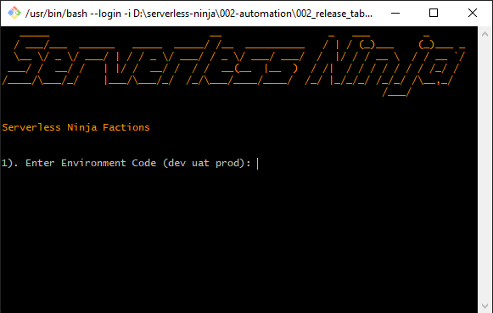
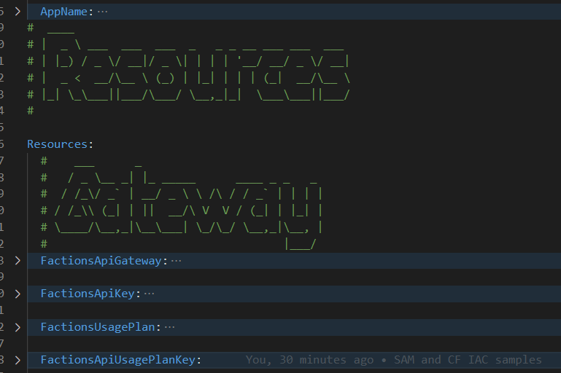
Have fun playing with the IAC trainers.

Slide 18

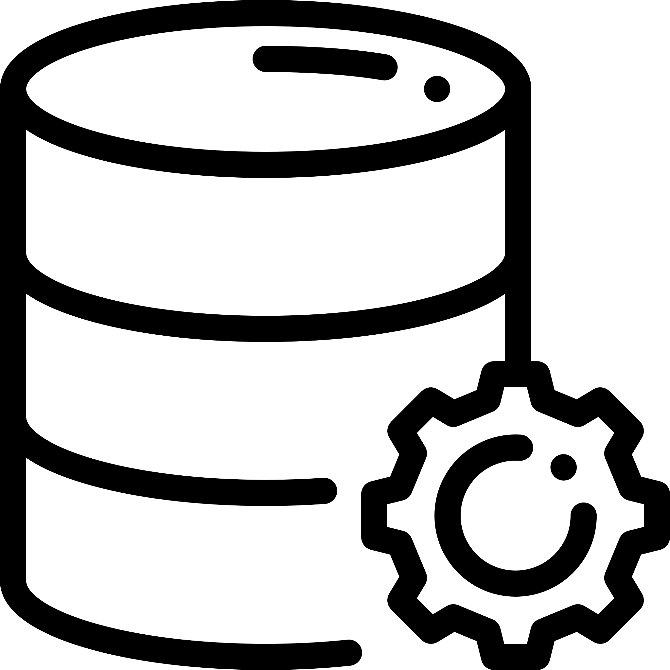

Serverless
is not limited
to Lambdas

Slide 19

The most common misconception about serverless is:
Serverless = AWS Lambda

Slide 20



Database
Queues
File Buckets
CI / CD Tools
Any AWS service that you don’t manage at the OS level is serverless

Slide 21





DynamoDB
Lambda
SQS
X Ray
API Gateway
The most popular AWS serverless services for building APIs

Slide 22

AWS Lambda have a
good amount of
Integration Points

Slide 23


Tons of people are skeptical about
Lambda’s integration capabilities.

Slide 24
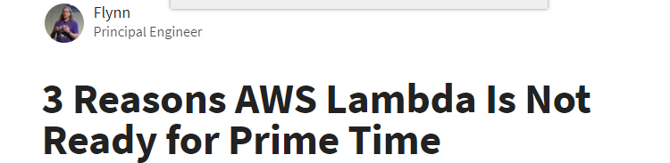
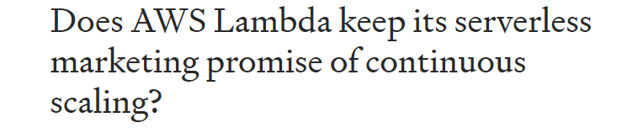
Back in 2016 people are bashing lambda big time

Slide 25
But hey, it has been almost
5 years since 2016.
AWS Introduced cool integrations since

Slide 26
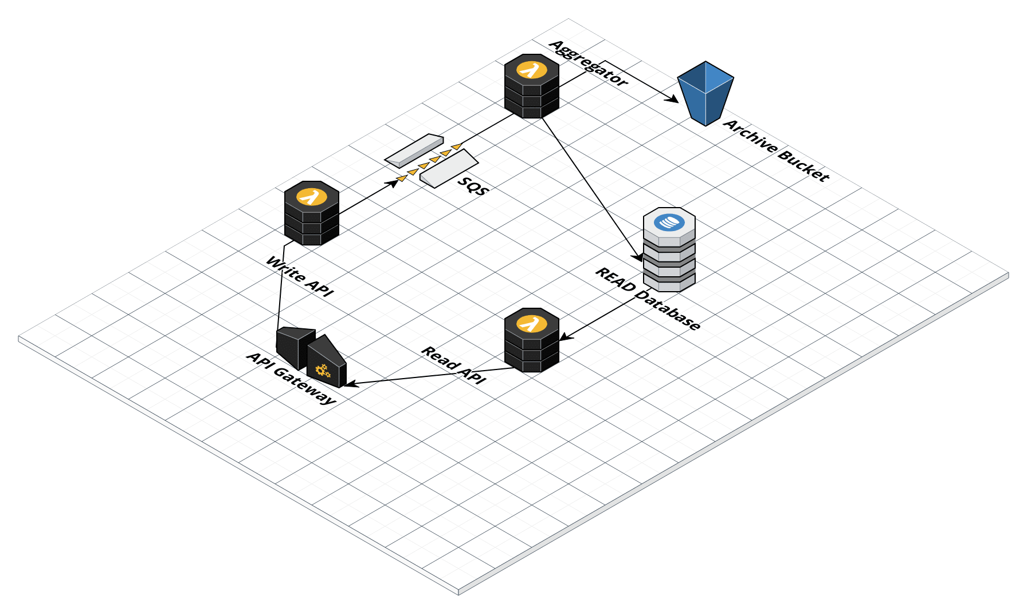
Basic CQRS using Lambda

Slide 27
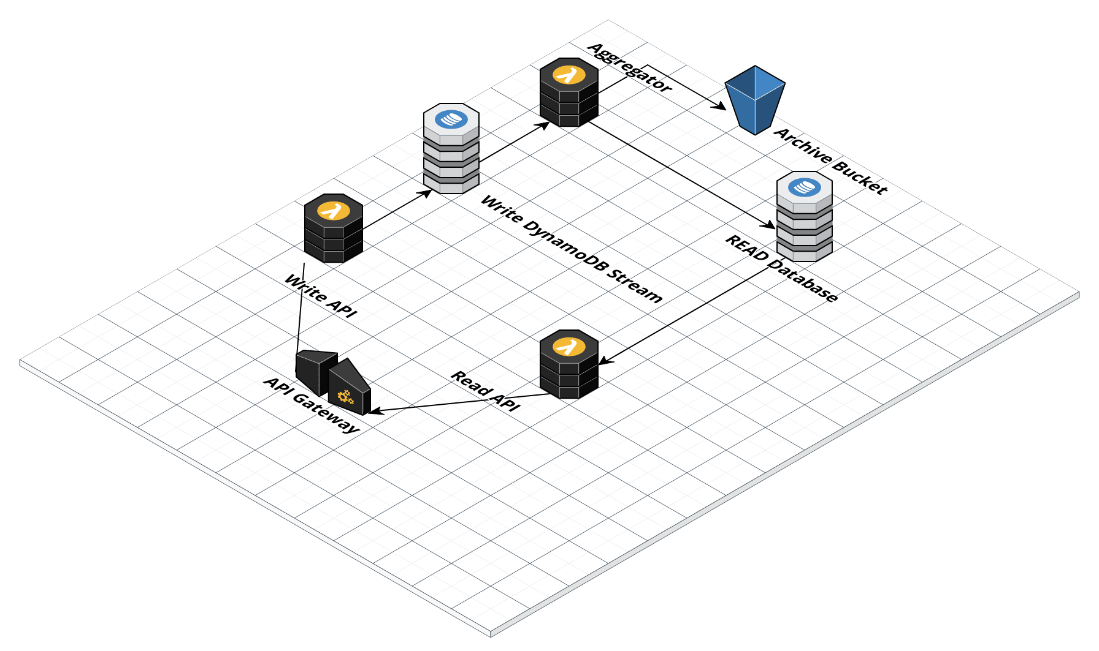
CQRS & DynamoDB Streaming

Slide 28

Lambda Integrations
https://docs.aws.amazon.com/lambda/latest/dg/lambda-services.html

Slide 29

Run shared code using
Lambda Layers

Slide 30


Lambda-based APIs require each endpoint to be packaged in isolation

Slide 31

Which often leads to
CODE DUPLICATION

Slide 32


Shared Code
Dependencies
Notorious Duplicates

Slide 33

To solve duplication issue:
Use Lambda Layers

Slide 34


Centralized Dependencies
Easier Code Updates
Smaller Deployments
Benefits

Slide 35

Sample API
Implementation using Lambda Layers

Slide 36

Integrating vs Infusing
Artificial Intelligence in
your APIS

Slide 37

Digital Transformation have recently gained tons of traction and AI is riding this wave

Slide 38

Integrating with AI APIs
Infusing AI to your APIs
Lucky for us, we can either infuse or integrate AI Models to Lambda APIs

Slide 39
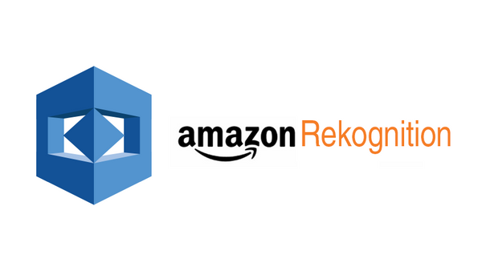
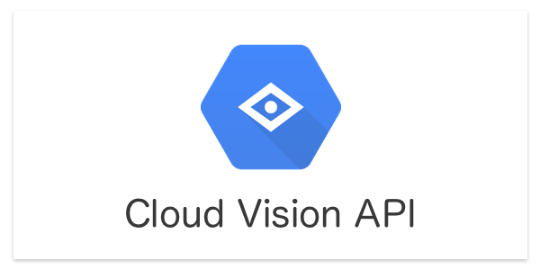
Integration with a base API powered by AI

Slide 40

Blog used for integrating Google Cloud Vision using NodeJS and Lambda by Alex DeBrie
https://www.serverless.com/blog/google-cloud-functions-application

Slide 41
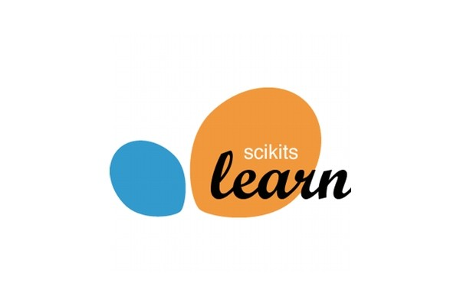
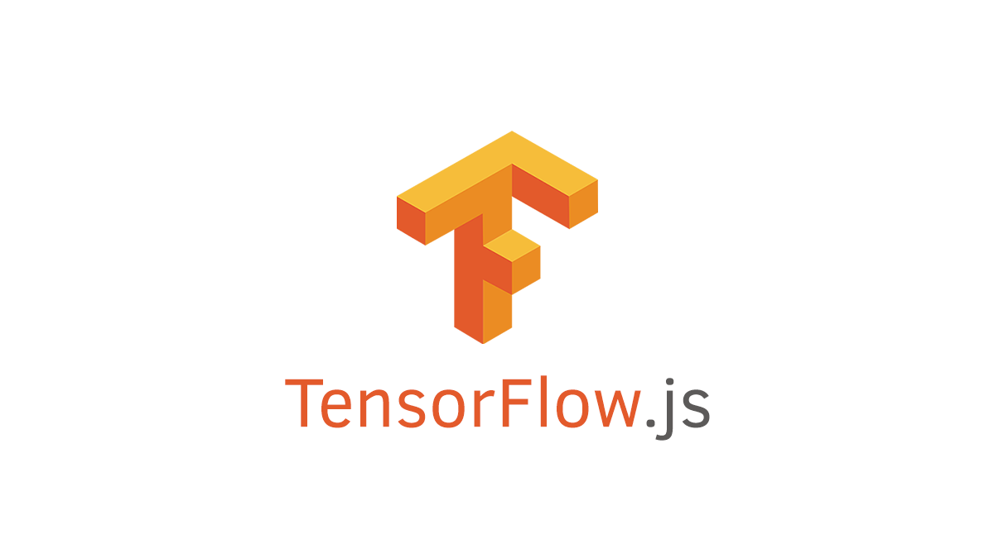
Infusing / Packaging Custom Built AI Models to your APIs

Slide 42
An unorthodox approach on how can you achieve high accuracy ML is by combining multiple models in an election system inside the API

Slide 43

How to embed Scikit Learn Models inside Lambda Functions by Will High
https://www.highonscience.com/blog/2017/09/29/ml-scoring-service-on-aws-lambda/

Slide 44

Integrating RPA
in your Serverless APIS

Slide 45



Manual Process Automation
Data Scraping & Market Intelligence
Integration with Legacy Systems
RPA is a huge advantage in the Insurtech World.

Slide 46
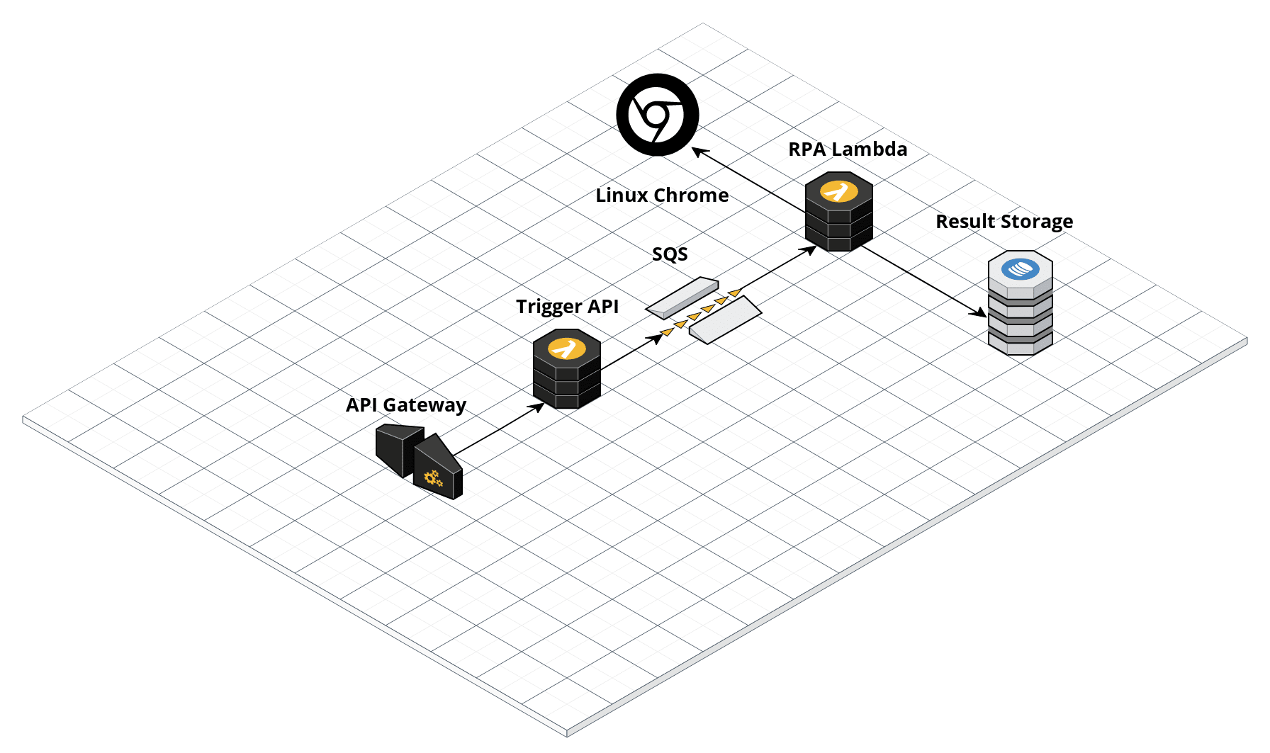
Typical Severless RPA Integration

Slide 47

Asynchronous API triggering RPA worker using AWS Lambda
https://bit.ly/3kW9sTM

Slide 48

Serverless have
Limitations

Slide 49

Its rewarding to be mindful about serverless limitations when proposing to your boss

Slide 50
3 GB
6 MB
15 Mins
Memory Limitation
Invocation Payload
Max Execution Time
200
30 Secs
Max Resource per Cloud Formation Stack
API Gateway Max REST Timeout

Slide 51

Wrestling with
Coldstart

Slide 52



VPC
Poor Choice of Language
Heavy Dependencies
Too much code
VPC Integration
Common Causes of Coldstart

Slide 53




VPC
Pick GO, JS and Python
Use Lamba Layers
Minimize VPC
Keep Warm
Coldstart Busters

Slide 54

Serverless is
NOT for everything

Slide 55



B2B Services
State Law vs Foreign Data Storage
On-Premise
It can be rewarding to utilize Docker and K8s on certain cases

Slide 56

Questions & Answers Section

Slide 57
Credits to the following:
Joel Khoo (Ninja Captain)
Michel Do (Chatbot Master)
Nattavit Kamoltham (CI/CD & AI)
Jon Scheele for the invite

Slide 58
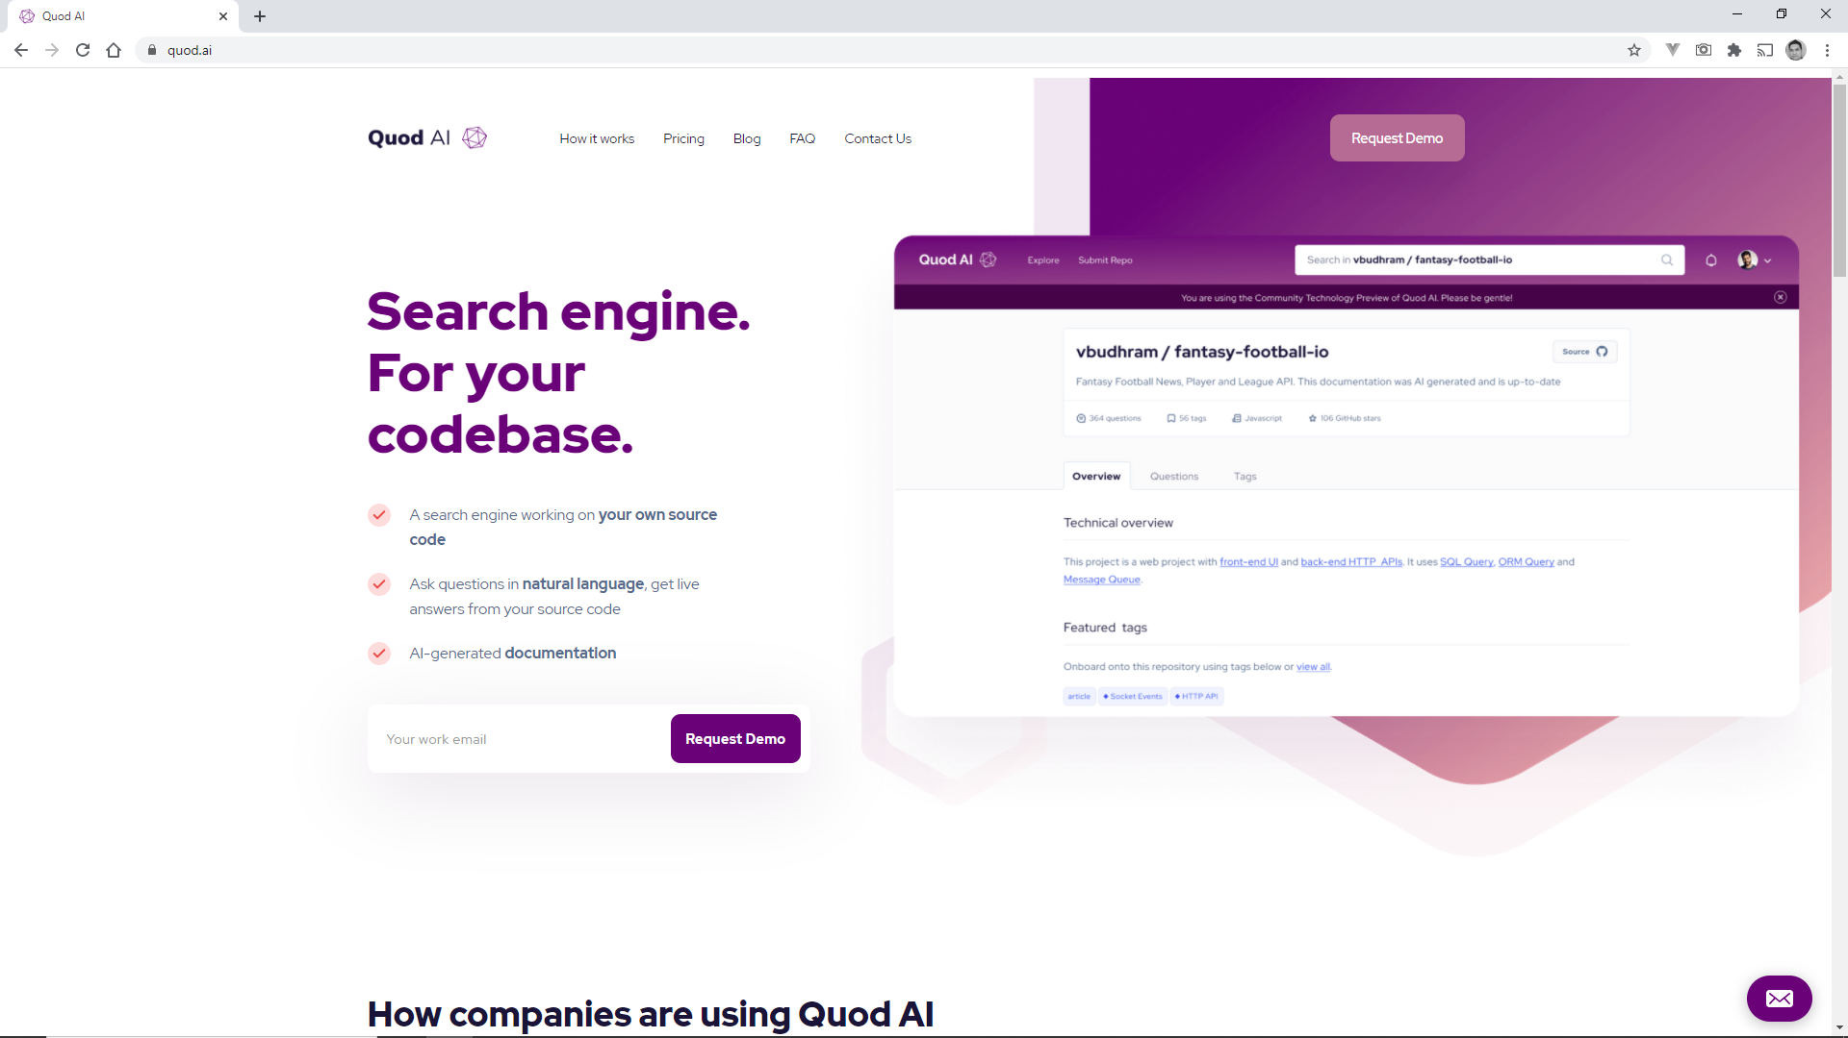
Searching Serverless Codebase is easier with Quod AI

Slide 59

Thanks for listening to my propositions

